Slide 1

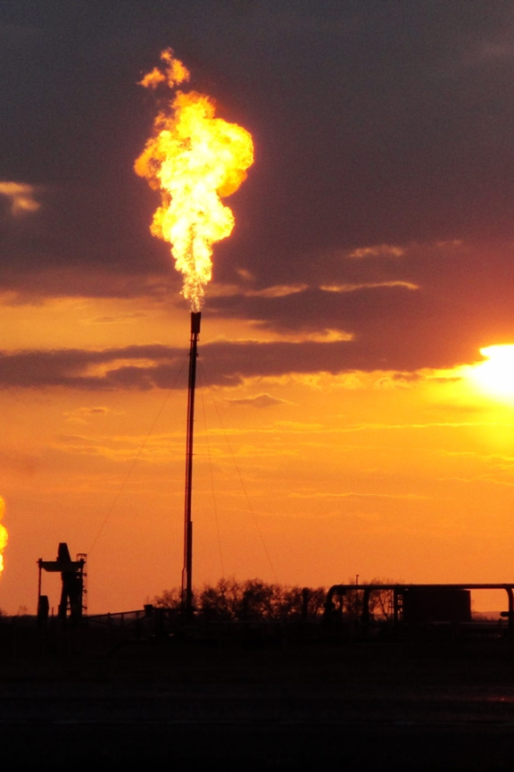
Global Warming: The Urgent Planetary Crisis
Join us on a journey to explore the alarming reality of global warming, its causes, effects, and the strategies we can implement to combat it. Let's take action now!

Slide 2
Introduction/Overview of Global Warming
Global warming refers to the long-term increase in Earth's average temperature. The primary cause is the greenhouse effect, where certain gases trap heat in the atmosphere. This leads to various severe consequences for our planet.

Slide 3
Causes of Global Warming
1
Burning Fossil Fuels
Human activities, including the burning of coal, oil, and gas, release large amounts of greenhouse gases, such as carbon dioxide (CO2), into the atmosphere.
Deforestation
2
Massive deforestation contributes to global warming as trees absorb CO2 and their removal reduces the planet's capacity to absorb it.
3
Industrial Processes
Industrial activities, such as cement production and chemical manufacturing, emit greenhouse gases, amplifying the planet's warming.

Slide 4
Effects of Global Warming
1
Rising Sea Levels
2
Extreme Weather Events
As temperatures increase, glaciers and ice caps melt, causing sea levels to rise and threatening coastal communities.
Global warming intensifies hurricanes, droughts, heatwaves, and other extreme weather phenomena, endangering human lives and ecosystems.
3
Disruption of Ecosystems
4
Health Impacts
Climate change disrupts natural habitats, leading to the loss of biodiversity and threatening countless plant and animal species.
Rising temperatures can exacerbate the spread of vector-borne diseases, affect air quality, and harm human health and well-being.

Slide 5
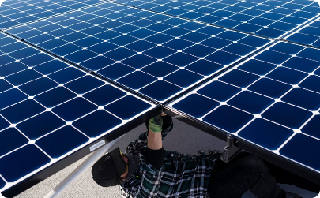
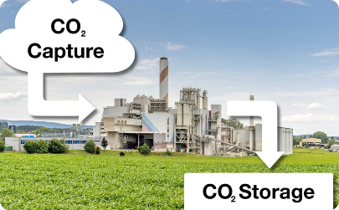
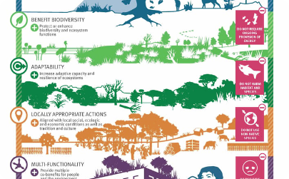
Mitigation and Adaptation Strategies for Global Warming
Renewable Energy Transition
Carbon Capture and Storage
Nature-Based Solutions
Protecting and restoring natural ecosystems, such as forests and wetlands, can absorb CO2 and enhance climate resilience.
Accelerating the shift towards renewable energy sources like solar and wind power is crucial to reducing greenhouse gas emissions.
Developing and implementing technologies to capture and store CO2 emissions can help mitigate global warming.

Slide 6
Role of Human Activities in Global Warming
Transportation
Agriculture
Waste Management
Fossil fuel-powered vehicles are a significant source of greenhouse gas emissions.
Intensive livestock farming and the use of synthetic fertilizers release methane and nitrous oxide, prominent greenhouse gases.
Improper waste disposal generates methane emissions from landfills, contributing to global warming.
Encouraging sustainable transportation options, such as electric vehicles and public transport, can help curb global warming.
Implementing effective recycling and waste reduction strategies is crucial for mitigating climate change.
Adopting sustainable agricultural practices and reducing food waste are essential in combating global warming.

Slide 7
Impacts of Global Warming on Environment and Wildlife
Coral Reefs at Risk
Arctic Ice Loss
Rising water temperatures cause coral bleaching, threatening the biodiversity and beauty of these delicate marine ecosystems.
Melting Arctic ice poses a great danger to polar bears and other Arctic species, disrupting their habitats and food sources.
Range Shifts and Extinction
Altered Migration Patterns
As temperatures change, plant and animal species must adapt or face extinction, leading to significant ecological imbalances.
Global warming affects the timing and routes of migration for birds and other animals, potentially disrupting vital ecosystems.

Slide 8

Conclusion and Call to Action
Global warming demands immediate action. By embracing sustainable practices, transitioning to renewable energy, and advocating for climate policies, we can safeguard the planet for future generations.

